Slide 1
Urban Data Lab Capstone Project Real-time Sensor Anomaly Detection Proposal Presentation
Data 599 Mitch Harris, Ryan Koenig, Nathan Smith May 11, 2021

Slide 2
Outline
1. Urban Data Lab
2. Project Overview
3. Project Management
4. Project Status

Slide 3

Urban Data Lab (UDL)
Founded in 2019 to advance data access, data management and data analytics capabilities on the University of British Columbia campus with the goal of addressing campus-wide sustainability challenges.
Provides open access of UBC sustainability data to researchers, policymakers and operational staff.
Supports the monitoring and measurement of sustainability performance for buildings, transportation, and specifically as it relates to the policy commitments of UBC Sustainability Initiative and Campus and Community Planning.

Slide 4
Urban Data Lab (UDL)
The UDL Team includes:
Mike Kennedy, Ph.D. - Project Lead
High-level involvement in the Capstone Project
Jiachen Wei, MDS – Research Assistant
Main point of contact for Capstone Project
Previous MDS Okanagan alumni
Ibrahim El-chami, Ph.D. – Postdoctoral Researcher
Will be supporting the Capstone Project and specializes in IoT and AI systems as part of smart energy systems

Slide 5
Project Overview
Real-time Anomaly Detection with Smart Building Sensor Data

Slide 6
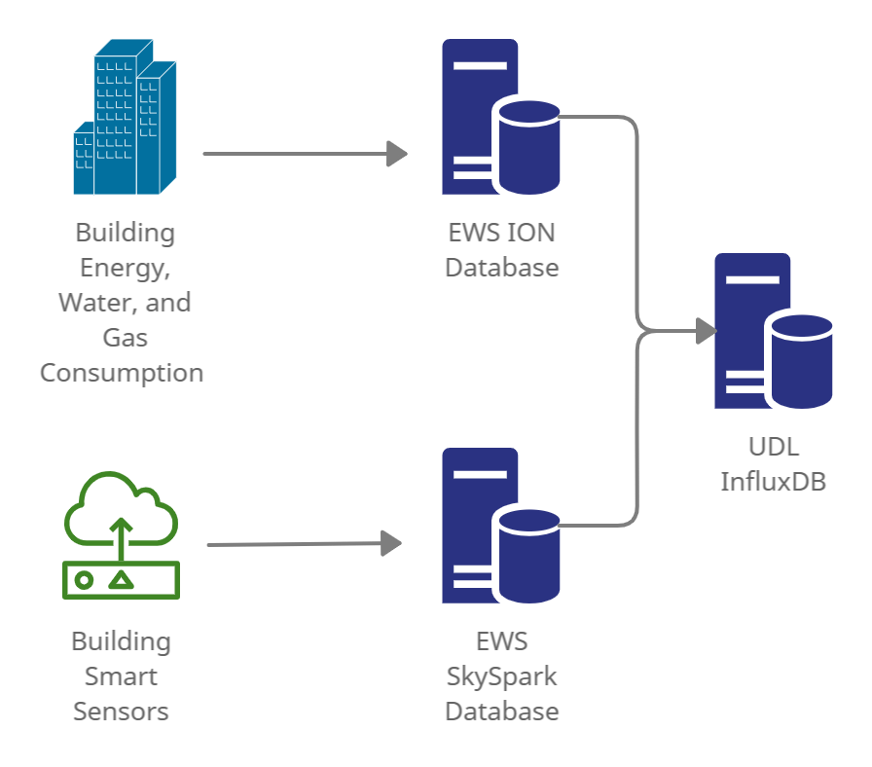
Project Overview Background
UDL has access to building sensor data managed by UBC Energy and Water Services (EWS)
The EWS data are stored on two databases: ION and SkySpark
UDL has access to these databases and records data in InfluxDB

Slide 7
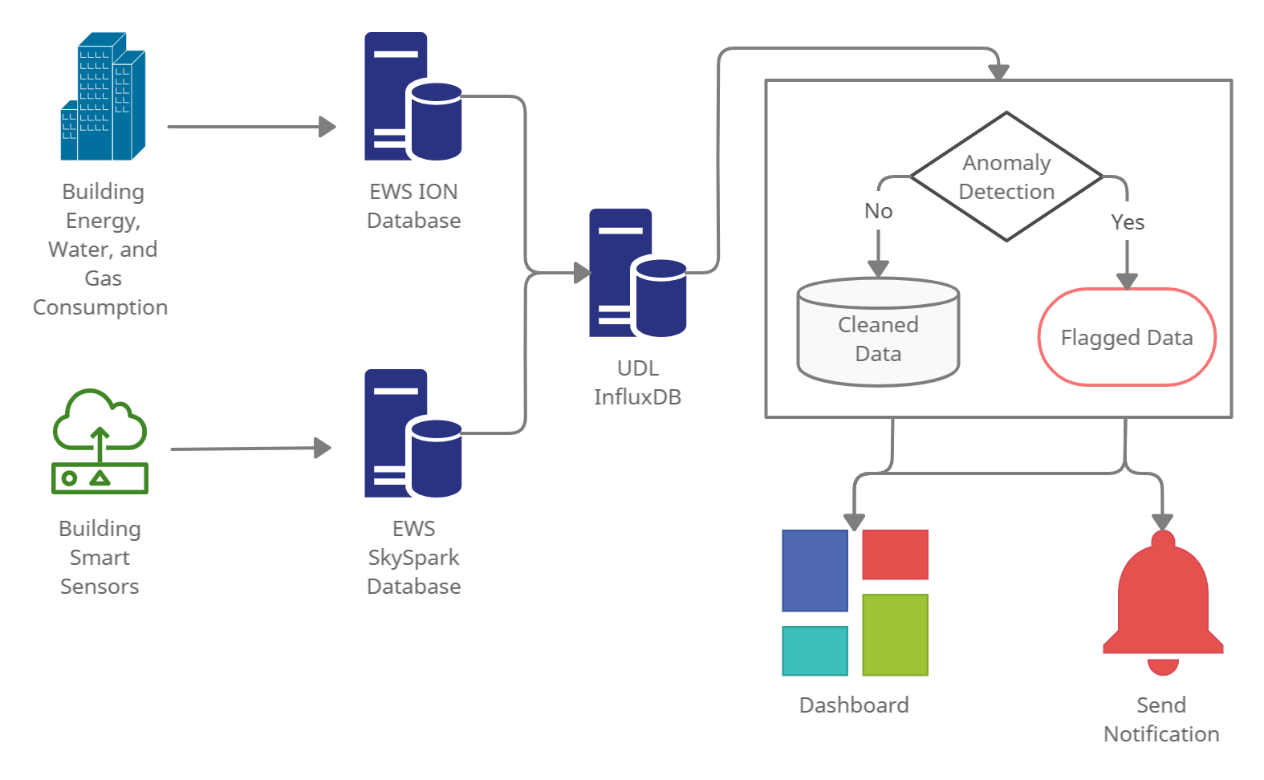
Project Overview Background
UDL have noticed inconsistent/erroneous data and there is no system currently in place to catch or flag these data
UDL are interested in deployment of an anomaly detection system capable of notifying users of unusual behavior

Slide 8
Project Overview Approach
Select a subset of SkySpark data and simulate real-time streaming from InfluxDB
Various anomaly detection models will be explored
A pipeline with the anomaly detection model and any required data cleaning will be tested using the simulated streaming data
The system may be twinned in Azure
The system may be tested/implemented on additional data sources
Output from the detection model will be provided in dashboard format, ideally with a notification system

Slide 9
Project Overview Schedule
Weekly goals are provided to define the scope and allow continuous tracking
Each goal has a subset of items (described in more detail in the proposal)
Week | Goal
1 | Project Definitional and Proposal
2 | Data and System Understanding
3 | Anomaly Detection Model
4 | Implement Streaming Pipeline
5 | Value Week
6 | Dashboard
7 | Reporting

Slide 10
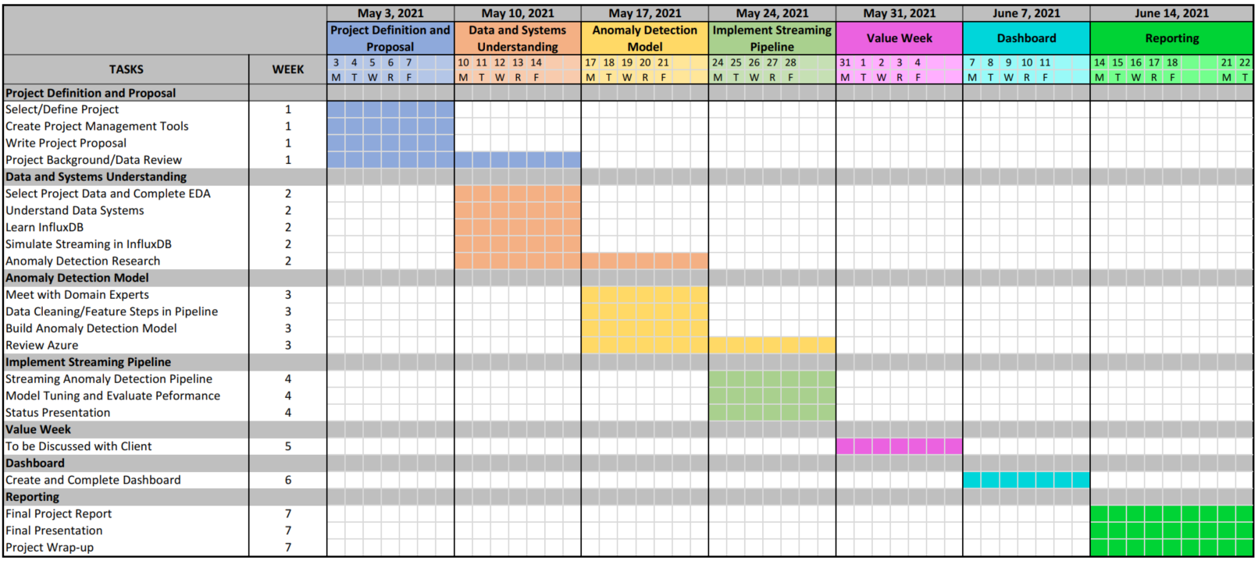
Project Overview Schedule

Slide 11
Project Management
Approach
Meetings / Communication
Description of Tools

Slide 12
Project Management Approach
One week sprints with weekly scrum meetings
High-level schedule tracking with Gantt chart
Task allocation and tracking using Kanban boards
Daily stand-ups
Twice weekly meetings with client
Templates setup for: meeting minutes, scrums planning, weekly presentations, logs

Slide 13
Project Management Meetings / Communication
Daily internal stand-ups at 10 am
Weekly scrum planning with client on Thursday
Weekly technical project meetings with client on Monday
Internal MDS Team slack channel used for general team communication
External slack channel setup with client for client communication
OneDrive setup for file sharing with client

Slide 14
Project Management Description of Tools
GitHub repo for MDS Team project organization
Clubhouse.io for Kanban
Slack for internal and external communication
OneDrive for file sharing
Word/Excel/PowerPoint for templates

Slide 15
Project Status
Previous Week Summary (May 3-9)
Next Week Planning (May 10-16)
Timeline Reflection

Slide 16
Project Status Previous Week Tasks Completed
Initial kick-off meeting with UDL (Mon May 3)
Second meeting with UDL based on project selection (Wed May 3)
Set up project templates (meeting minutes, logs, team document)
Kanban project management setup on Clubhouse.io
Proposal, including:
Project background review
High-level data review
Proposal presentation

Slide 17
Project Status Previous Week Individual Contributions
Nate: Project templates, reviewed background information, proposal
Mitch: Project schedule, Kanban set up in Clubhouse.io, high-level literature review
Ryan: Reviewed background information, proposal

Slide 18
Project Status Previous Week Challenges
Defining project scope
Multiple project options provided (buildings vs traffic, vs natural assets data)
Constraining the scope given the project timeline
Timeline is tight given the 7 weeks instead of 9 from last year
There are multiple additional items that could be completed as part of this scope
Understanding data and systems
Multiple databases and many types of data, had to understand quickly to define the scope in a short period

Slide 19
Project Status Next Week Tasks
Week 2: Data and System Understanding
Select Data Subset and Complete Exploratory Data Analysis
Understand Data Systems
Learn InfluxDB
Simulate Streaming in InfluxDB
Anomaly Detection Research
Start Anomaly Detection Modelling (secondary)

Slide 20
Project Status Next Week Challenges
Learning Curve on Data Sources
Need to ensure we’re initially working with a constrained data set and the EDA is able to provide a good understanding of the data
Learning Curve on InfluxDB
Focus on learning what is needed quickly
Anomaly Detection
Have a short-list of methods and start on modelling as possible to keep on schedule

Slide 21
Project Status Timeline Reflection
Currently on track, heading into the first post-proposal week.

Slide 22

Q&A
Mitch Harris
Ryan Koenig
Nathan Smith
Photo by Markus Spiske on Unsplash

